Slide 1
Health Factors and Stroke Incidence
Group 1: Bhavesh Heetoo , Jana Khamis , Jiang Jun , Tala Zubi , and Paul Schaefer

Slide 2
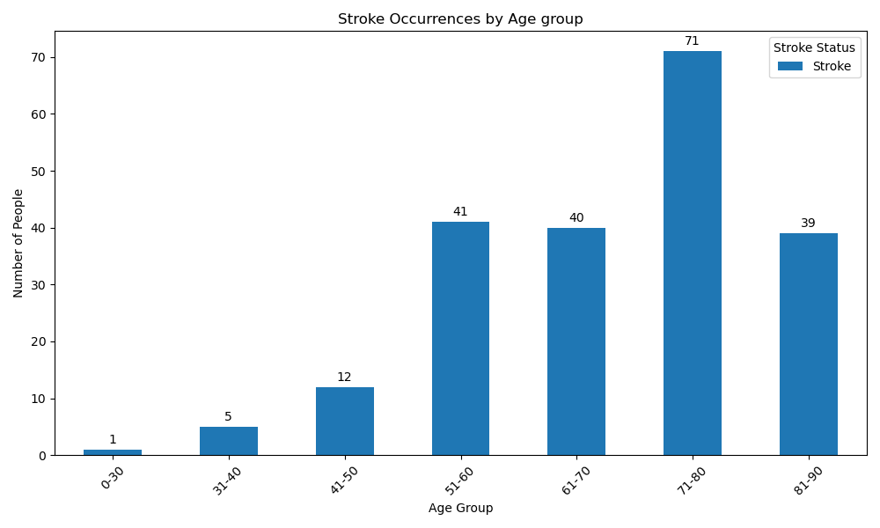
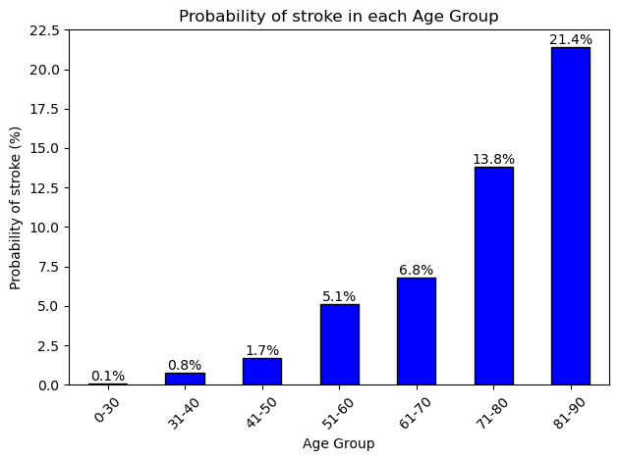
Does higher age increase risk of stroke?

Slide 3
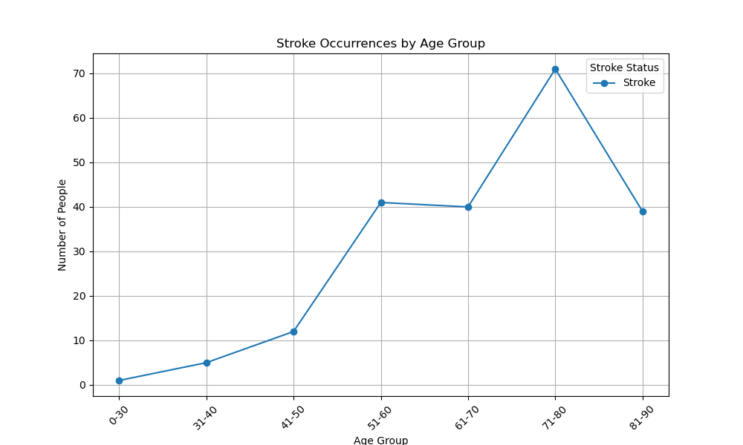
Does higher age increase risk of stroke?

Slide 4
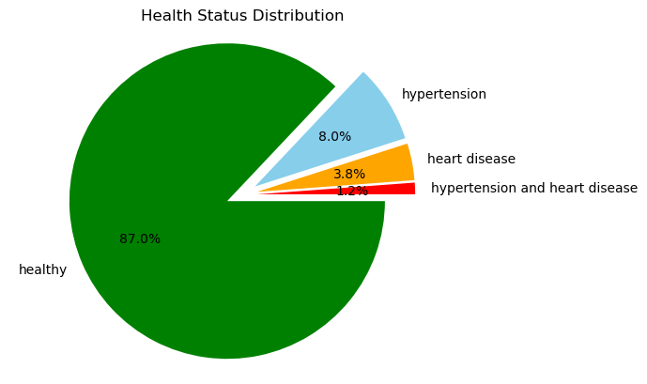
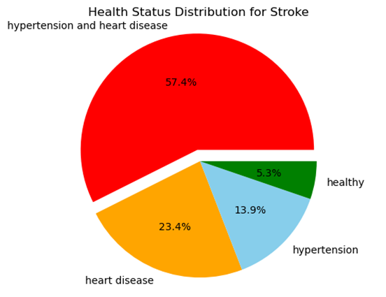
How do hypertension and heart disease impact stroke?

Slide 5
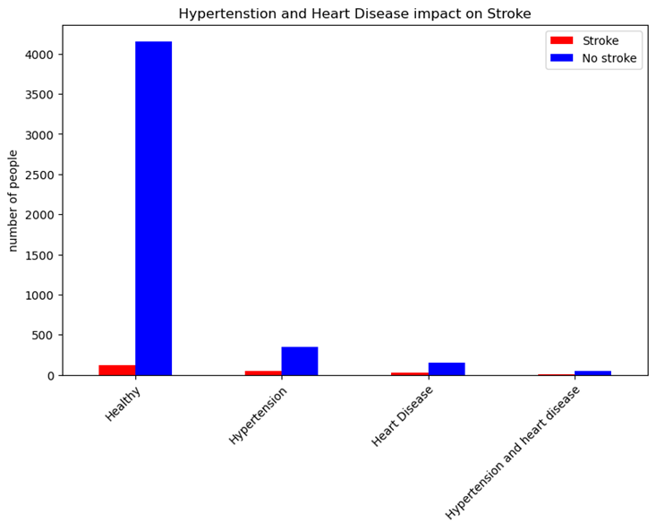
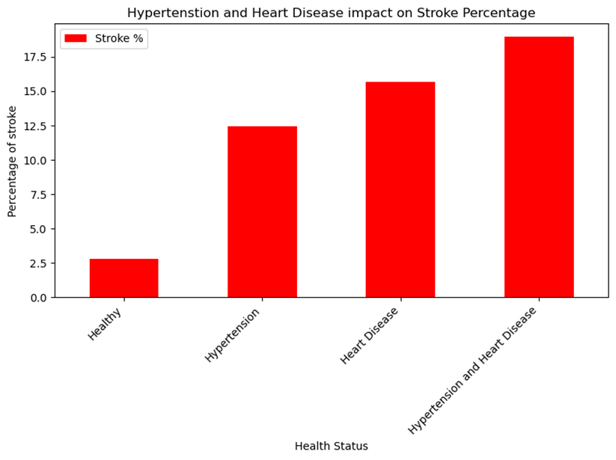
How do hypertension and heart disease impact stroke?

Slide 6
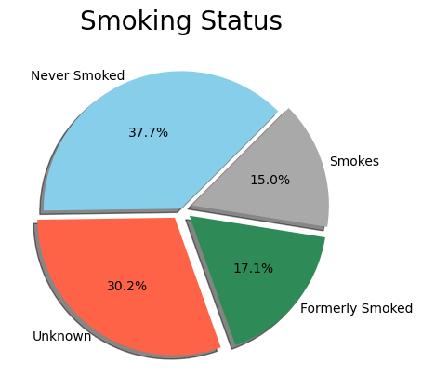
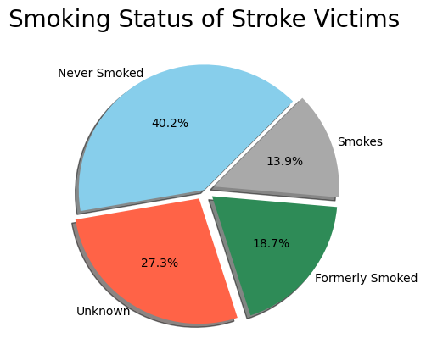
Does smoking status have an impact on likelihood of a stroke?

Slide 7
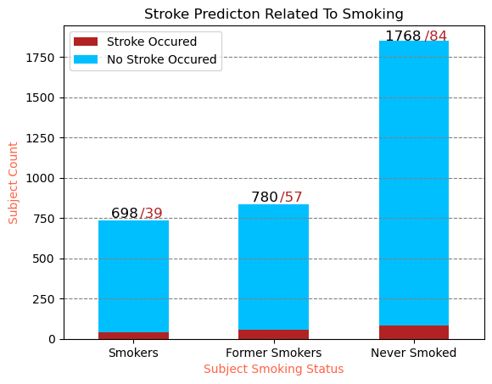
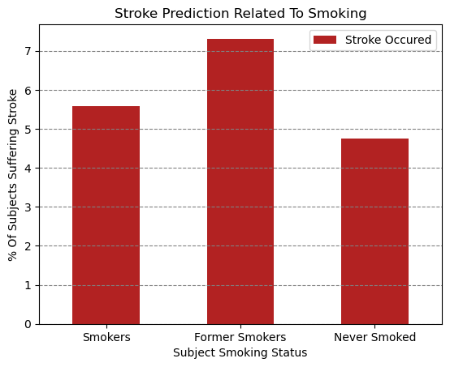
Smoking Impact p-value = 0.76, statistically insignificant.

Slide 8
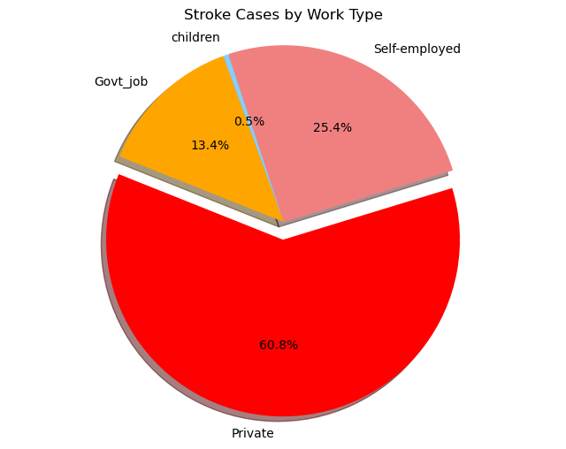
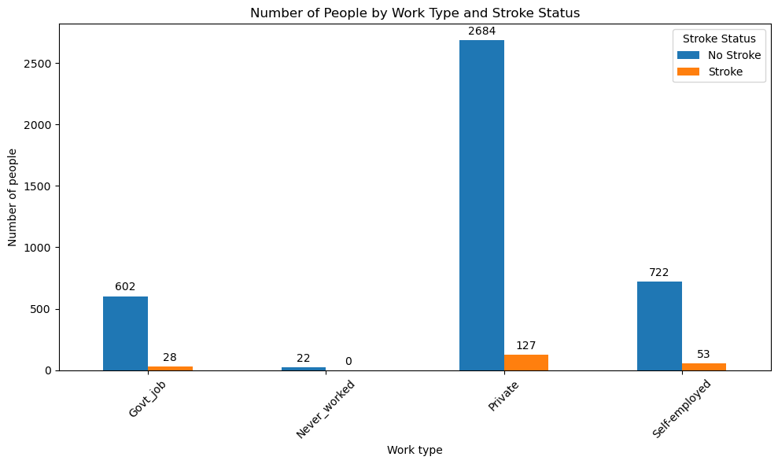
How do different types of work (Private, Self-employed, Govt_job, Never _worked) affect stroke risk?

Slide 9
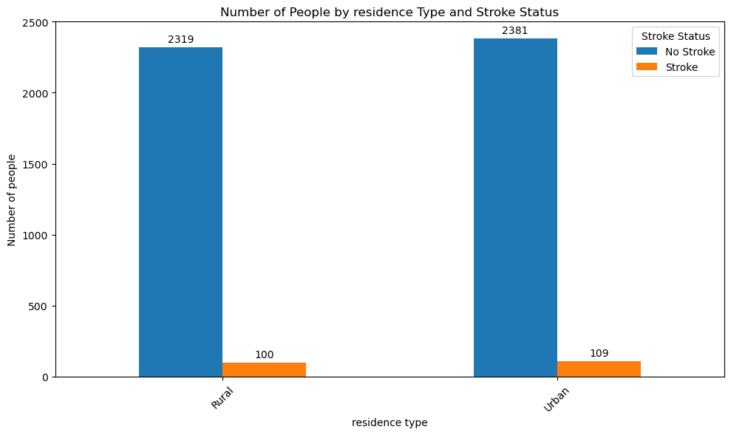
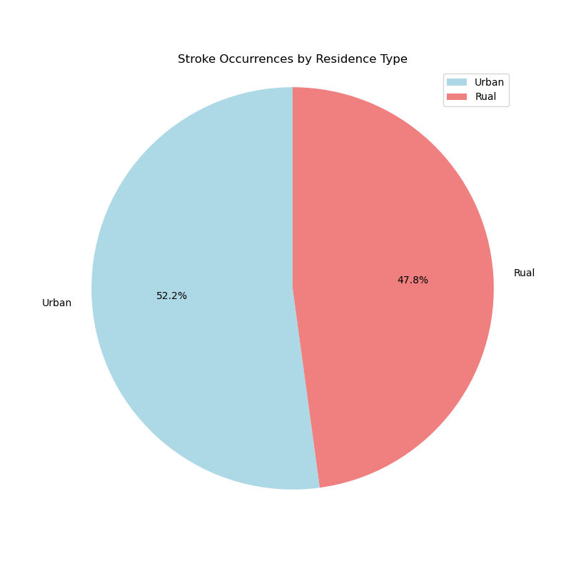
Does living in an urban or rural area affect stroke likelihood?

Slide 10
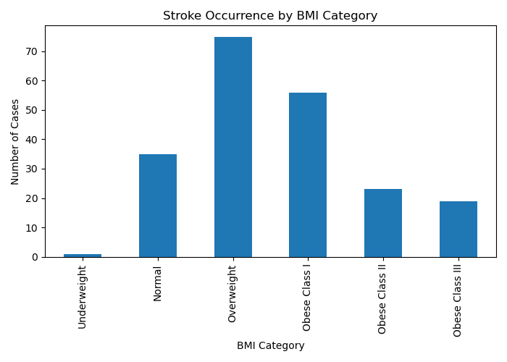
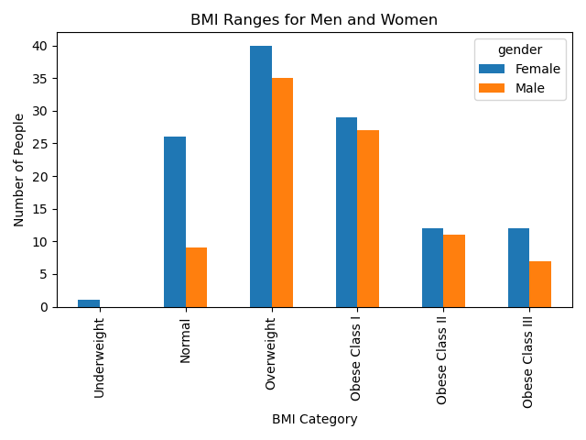
What is the relationship between BMI and stroke occurrence?

Slide 11
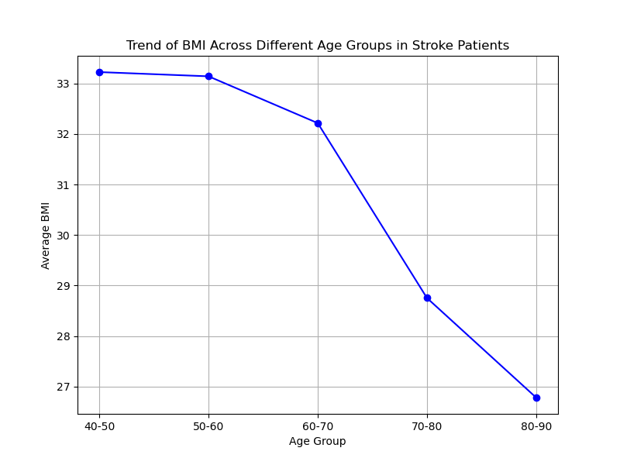
What is the relationship between BMI and stroke occurrence?

Slide 12
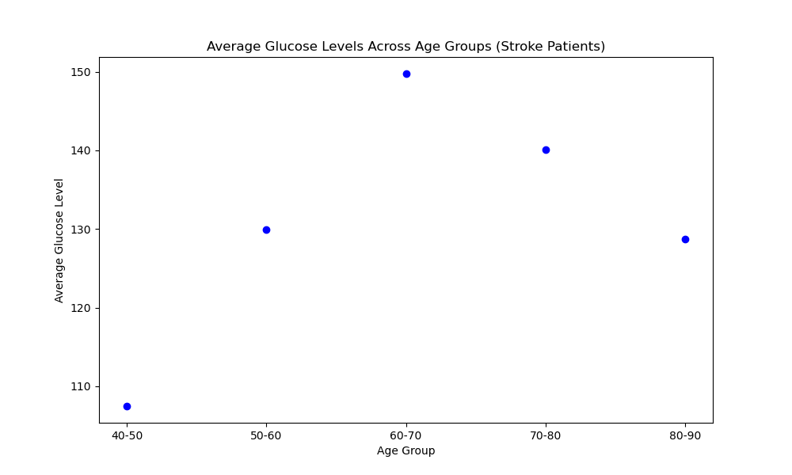
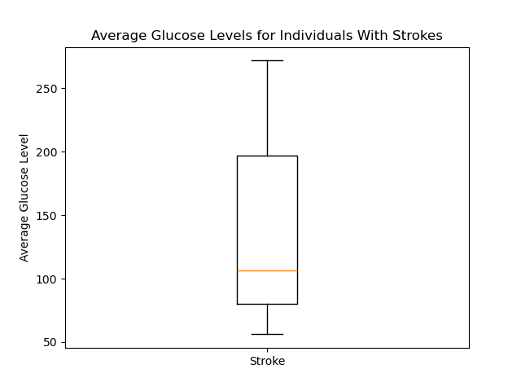
How do glucose levels vary across patients with stroke?

Slide 13
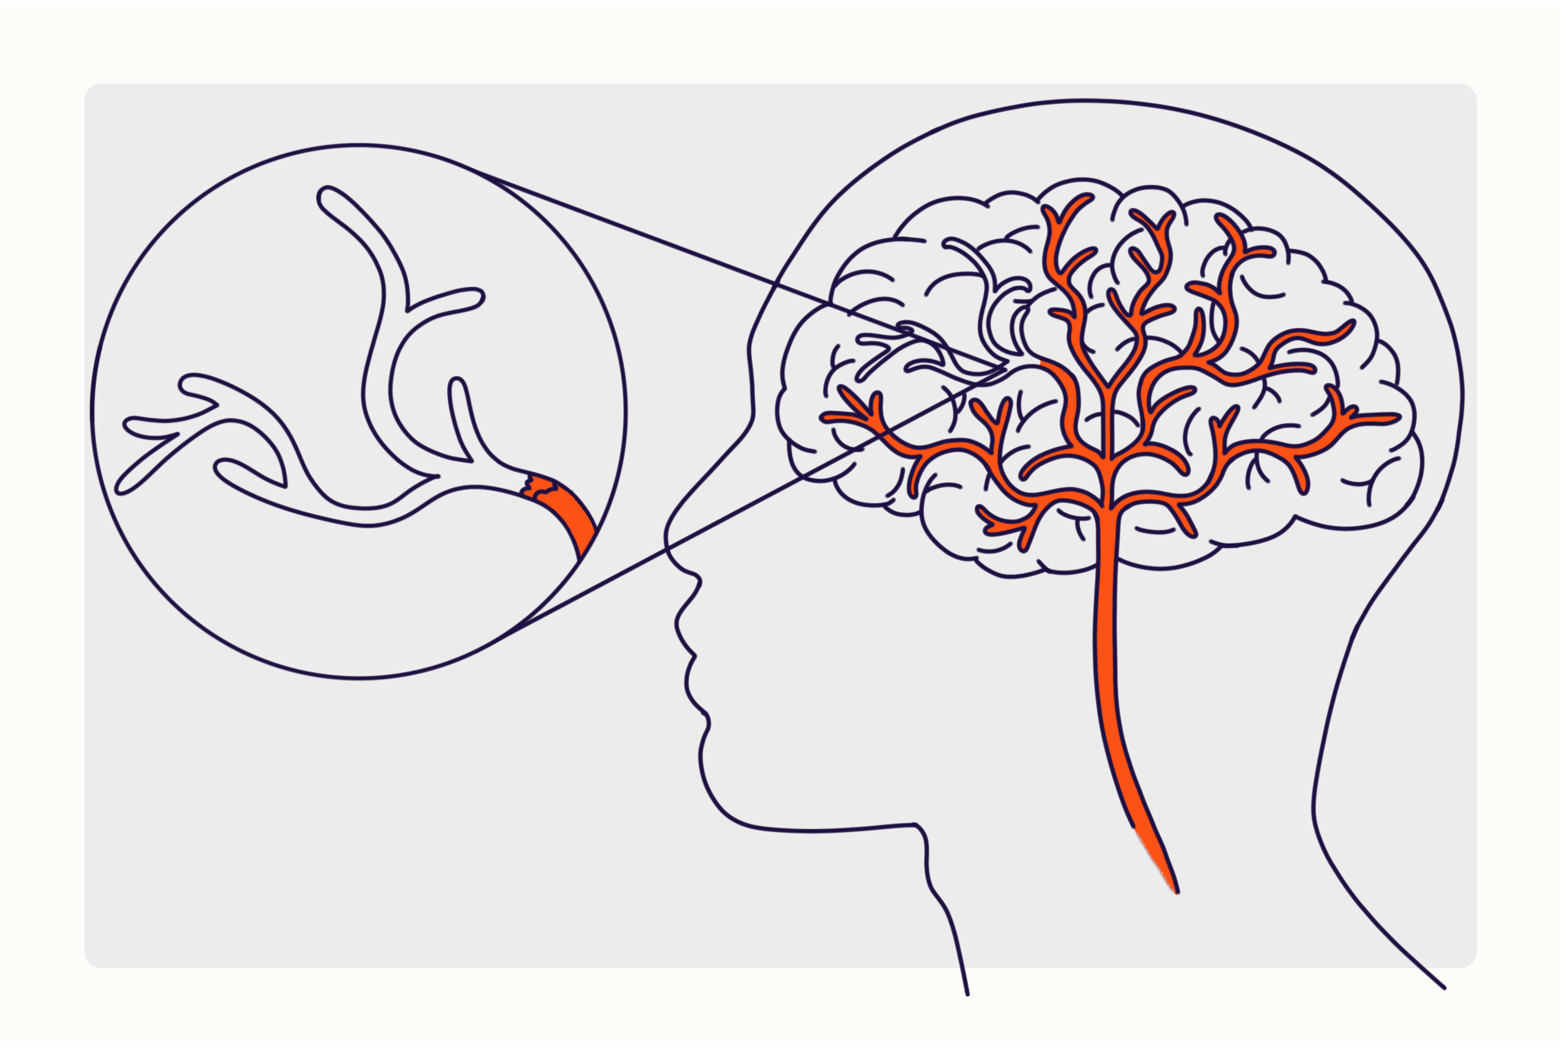

Conclusions and Limitations

Slide 14
References
Fedesoriano. “Stroke Prediction Dataset.” Kaggle, 26 Jan. 2021, www.kaggle.com/datasets/fedesoriano/stroke-prediction-dataset/data.

